Slide 1




MANISHA TOMAR DATA ANALYTICS PORTFOLIO

Slide 2







Project analysis slide 3
Projects
1. GameCo.
2. Preparing for flu Season
3. Rockbuster
Global market analysis of video game sales.
Staff deployment planning for influenza season
Launching Rockbuster stealth online movie service
4. Instacart
5. Pig E. Bank
6. Conditions Contributing to COVID-19 Deaths
Market segmentation analysis to uncover sales
Analysis customer attrition

Slide 3

GameCo
ANALYZING GLOBAL VIDEO GAME SALES

Slide 4
Project analysis slide 5
GameCo. Market Analysis
ANALYZING GLOBAL VIDEO GAME SALES
About GameCo.
Game Co. is a global gaming leader, offering a diverse range of games for sale and rental across key markets.
Objective
The primary goal of this project was to analyze historical game data to identify key trends and patterns. The insights gained were aimed at predicting market reception for upcoming games, thereby informing strategic decisions for future releases.
Key Steps:
Data Cleaning: Identify and address missing values and duplicates.
Exploratory Data Analysis (EDA): Calculate key statistics, including mean, median, mode, maximum, & minimum.
Data Grouping, Filtering, and Summarizing: Utilize Pivot Tables for efficient data analysis.
Data Visualization: Create a column chart of total global sales by publisher and a line chart depicting average North American sales by year.
Type of Analysis: Determine whether to conduct Descriptive, Diagnostic, Predictive, or Prescriptive analysis.
Interpretation: Analyze results and summarize key findings.
Excel Functions Used: Find & Select, Replace, Replace All, Remove Duplicates.
GOALS
DATA LIMITATIONS
TOOLS USED
Analyze regional and temporal sales trends for informed
future decision-Making.
Data set represents unit of games sold, not their dollar value.
Excel, PowerPoint

Slide 5
Project analysis slide 8
GameCo. Market Analysis
ANALYZING GLOBAL VIDEO GAME SALES
Key Questions
Data
Are certain types of games more popular than others ?
What other publishers will likely be the main competitors in certain markets ?
Have any games decreased or increased in popularity over time?
How have their sales figures varied between geographic regions over time?
Data source: VGChartz.
File: Excel - CSV
Period of data: 1980-2016
Regions: North America, Europe, Japan, and others
Information: title, platforms, year, genre, publisher
Skills Applied
Challenges
For this project, I used Excel & Tableau for visualizations.
• Improving data quality
• Data grouping and summarizing
• Descriptive analysis, Pivot table
• Visualization results in Excel and Tableau
• Presenting results
This was my first project, and the main challenge was grasping the business requirements and converting them into meaningful analysis, as I was navigating entirely new territory

Slide 6
Project analysis slide 5
Analysis
The final analysis highlights popular game genres and regional sales trends since 1980, offering a detailed breakdown of top genres, platforms, and market share data.
Historical Trends 1980-2016
Recent Trends Analysis 2010-2016
Popular Platforms by Region
Sales Over Time in North America, Europe, and Japan
Total Sales by Genre with Regional Breakdown Genre
The top platforms are PS, DS, PS3, WII, PS2, X360

Slide 7
Project analysis slide 5
Insights & Recommendations
KEY LEARNINGS
Post-2015, regional preferences have diverged significantly, highlighting the need for tailored game development and marketing strategies.
Despite declining sales since 2010, Europe surpassed North America in market share after 2015, while Japan experienced a notable sales surge.
While Action, Shooter, and Sports genres dominate in North America and Europe, Japan has shifted towards Action games, with Role-Playing games remaining the second most popular.
Platform popularity has shifted significantly; PS2 and X360 have emerged as leaders in the West, replacing former favorites. In Japan, the enduring preference for the 3DS highlights distinct regional differences.
RECOMMENDATIONS
Global Marketing Strategy
Genre
Platform
Adapt marketing strategies to align with regional sales trends and shifting market preferences post-2015.
Develop advertising campaigns that resonate with regional tastes and current trends to enhance engagement and increase market share.
North America and Europe: Increase focus on Shooters and Sports genres, which continue to perform strongly.
Japan: Leverage the growing interest in Action genres while also prioritizing Role-Playing Games, which remain highly popular.
North America and Europe: Leverage the established console base, particularly the popularity of PS and Xbox One.
Japan: Continue to capitalize on the strong preference for handheld platforms like the 3DS.
General: Stay alert to emerging platforms to swiftly adapt to shifts in platform popularity.
Final Presentation

Slide 8
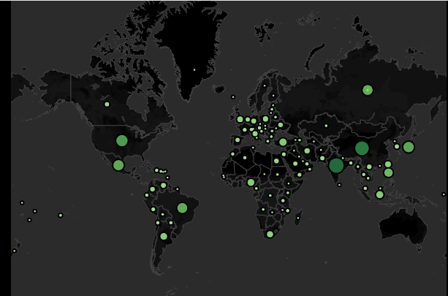
Flu Season
PREPARING FOR THE FLU SEASON IN THE U.S.

Slide 9
Project analysis slide 5
Preparing for Influenza Season
Project Overview: During flu season, U.S. healthcare facilities face increased patient volumes. This project aimed to develop a staffing schedule to address these demands, enhancing preparedness by effectively managing staffing at clinics and hospitals.
Motivation: Influenza season increases patient numbers, especially among vulnerable populations, requiring additional temporary staff from the medical staffing agency.
Scope: Analyze historical influenza data to forecast staffing needs, considering incidence rates, peak seasons, regional variations, and implications for temporary healthcare workers.
Key Steps: Conduct Exploratory Data Analysis (EDA):
Descriptive statistics: central tendency & distribution.
Create charts to visualize distribution, relationships, missing values, and outliers.
Clean data (including imputation) and transform it (e.g., merging spreadsheets).
Perform hypothesis testing (t-test in Excel).
Interpret and summarize results.
Excel Functions Used:
FIND & SELECT, REPLACE WITH, REPLACE ALL, REMOVE DUPLICATES.
PivotTables and SUMIFS for summarizing and aggregating data.
STAKEHOLDERS
GOALS
TOOLS USED
Medical agency frontline staff
Hospitals and clinics using staffing services
Influenza patients
Staffing agency administrators
Excel, PowerPoint, Tableau
Improve flu season readiness by optimizing staffing needs.

Slide 10
Project analysis slide 8
Preparing for Influenza Season
Key Questions
Data
Support staffing plan with data on medical personnel distribution in the U.S.
Investigate seasonality of influenza across states.
Prioritize states based on vulnerable population size and categorize as low-, medium-, or high-need.
Identify data limitations that hinder analysis.
Census Population Dataset Source: US Census Bureau Contents: Population information from the US by country, time, age and gender for 2009-2017.
Influenza Deaths Dataset Source: CDC Contents: Information about influenza deaths by age groups in the US by state and time for between 2009-2017.
Skills Applied
Challenges
A major challenge in this project was integrating diverse data sources for a cohesive analysis.
Additionally, managing 'suppressed' variables presented difficulties, initially creating uncertainties about their effective use in the analysis.
Translating business requirements into analytical questions
Sourcing relevant datasets
Data integration and cleaning
Statistical hypothesis testing, Forecasting ,
Visual analysis & Storytelling in Tableau
Presenting results to an audience

Slide 11
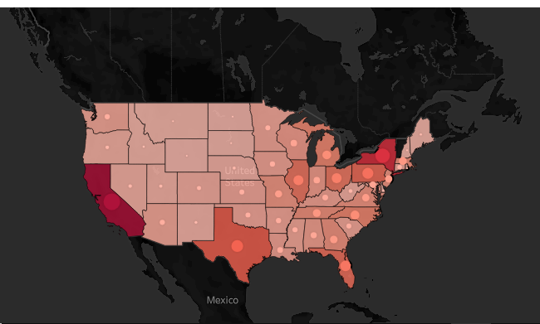
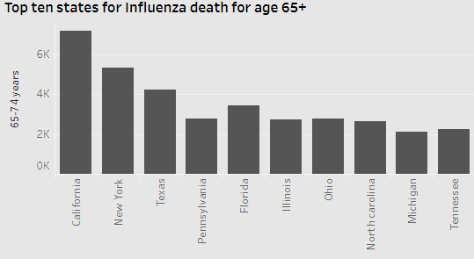
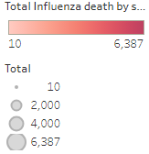
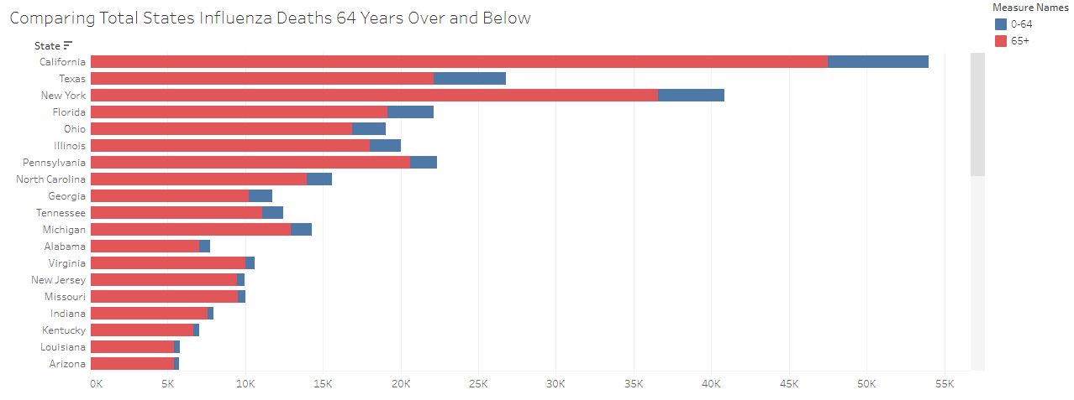
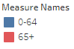
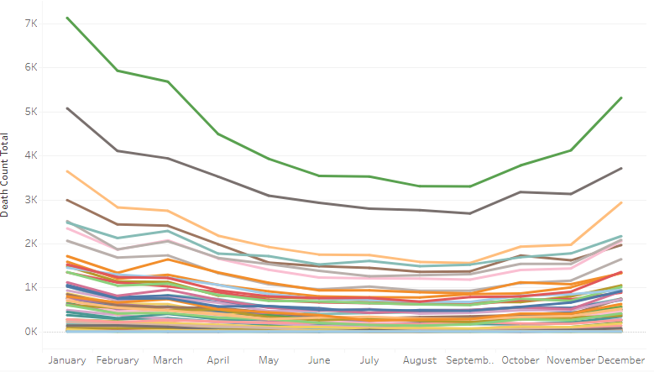
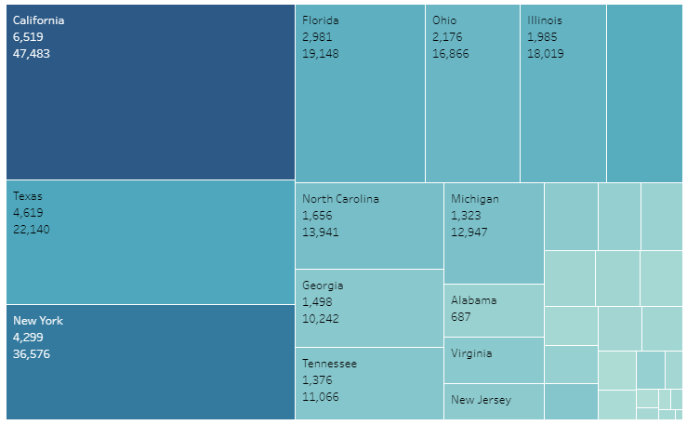
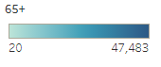
Project analysis slide 5
Analysis
In this analysis, staffing needs for a medical staffing agency were forecasted to optimize resource allocation during peak flu periods. A priority map was created, categorizing U.S. states from very high-need to very low-need based on their requirements, and the seasonality of flu outbreaks was analyzed.
Total Influenza death in US for the year 2013
Influenza Death & Age
Seasonality
Priority Map

Slide 12
Project analysis slide 5
Insights & Recommendations
KEY LEARNINGS
States with a larger population of individuals aged 65 and older experience a higher number of influenza-related deaths.
Influenza deaths usually increase in December, peak in January, and stay high through February and March, consistently across states and regions.
The virus's impact on vulnerable age groups underscores the need for targeted interventions and preventative measures.
RECOMMENDATIONS
Priority
Seasonality
Further Analysis
States with significant populations aged 65 and older should boost their medical staffing during the influenza season. The most critical states are California, New York, Texas, and Pennsylvania.
To prepare for the influenza season, which runs from December to March, medical staff should be allocated to each state according to its priority level.
States with smaller populations or fewer individuals over 65 but higher influenza death rates should be examined more closely to identify other contributing factors.
Future analysis should investigate the impact of influenza on additional vulnerable groups, such as pregnant women, individuals with HIV/AIDS, and those with other conditions.
LINKS & DELIVERABLES
Tableau Story Board
Interim Report

Slide 13
Rockbuster Stealth LLC
Transition to Online Video Rental Service

Slide 14
Project analysis slide 5
Rockbuster Stealth LLC
Project Overview: Strategic Analysis and Data-Driven Recommendations for Rockbuster Stealth LLC
Background: Rockbuster Stealth LLC, a global movie rental company, has traditionally relied on physical stores. With rising competition from digital platforms like Netflix and Amazon Prime, Rockbuster is exploring a shift to online video rentals.
Objective: This project aims to leverage data analytics to address key business questions and shape Rockbuster's 2020 strategy for transitioning to an online service model. The insights gathered will be crucial in guiding decision-making and strategic planning.
Key Steps:
Data Extraction: Utilized SELECT, JOIN, and WHERE clauses to retrieve relevant data from multiple tables.
Data Dictionary: Developed an Enterprise Relationship Diagram (ERD) using DbVisualizer.
ERD Extraction: Extracted the ERD from Rockbuster’s database using DbVisualizer.
Data Aggregation: Applied GROUP BY and aggregate functions like SUM, AVG, and COUNT to summarize data.
Data Filtering: Used HAVING clauses to filter aggregated results.
Data Visualization: Created bar charts, line charts, scatter plots, and other visualizations
Excel
PowerPoint
Tableau
DbVisualizer
SQL/PostgreSQL
TOOLS USED

Slide 15
Project analysis slide 8
Rockbuster Stealth LLC
Key Questions
Data
1. Which movies contributed the most/least to revenue gain?
2. What was the average rental duration for all videos?
3. Which countries are Rockbuster customers based in?
4. Where are customers with a high lifetime value based?
5. Do sales figures vary between geographic regions?
Data Source: Postgres Tutorial Data Set
Skills Applied
Challenges
Relational databases , SQL (Link to Queries)
Creating a data dictionary, Database querying
Data filtering, Data cleaning and summarizing Joining tables Subqueries
Common table expressions
Presentation
Challenges included managing complex queries and maintaining data accuracy.

Slide 16
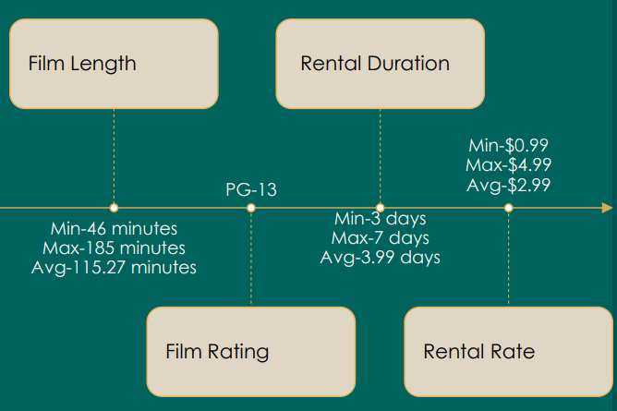
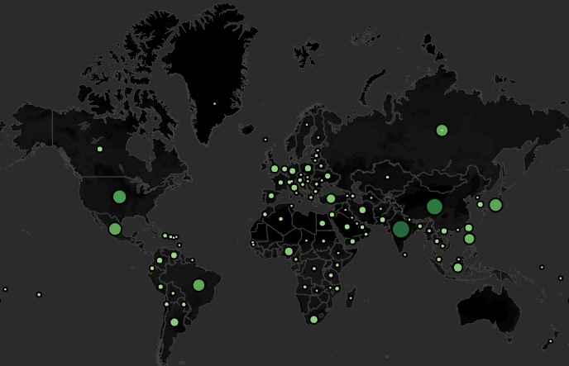
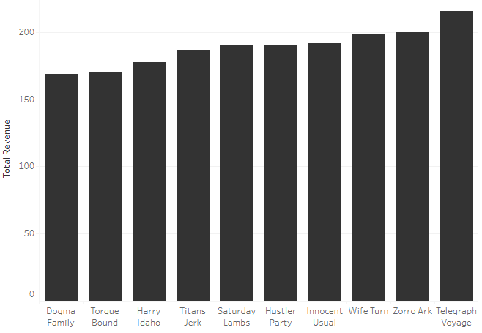
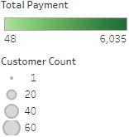
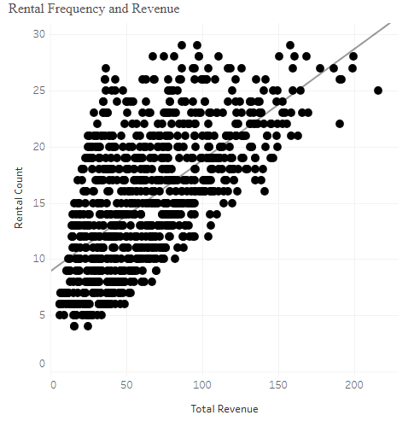
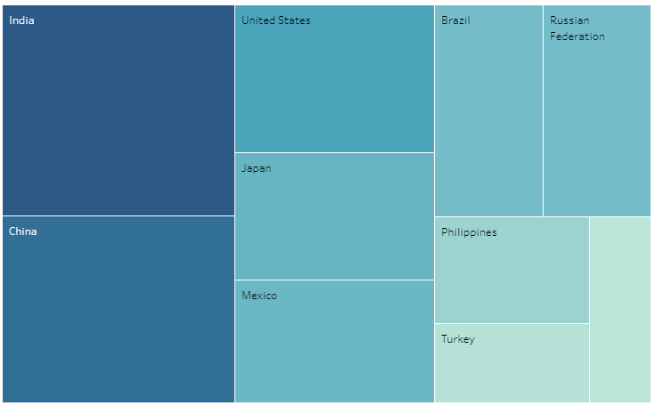
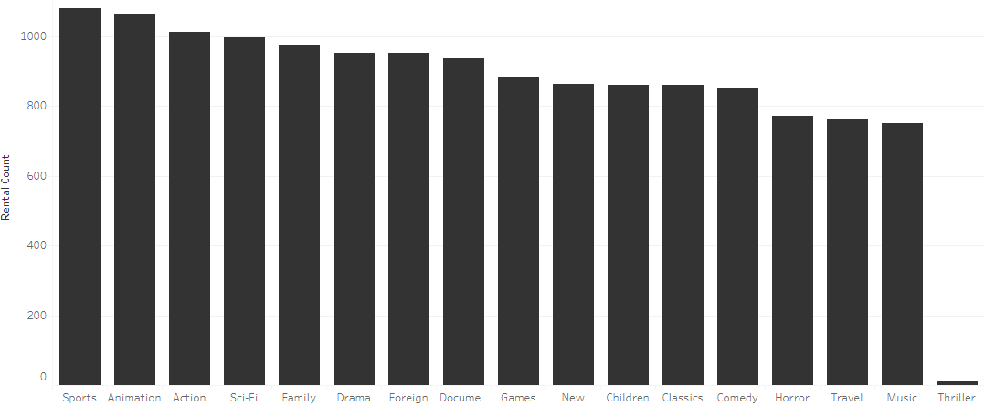
Project analysis slide 5
Analysis
Rockbuster's data was efficiently managed within a PostgreSQL database, with data integrity enhanced through meticulous cleaning and validation. SQL was utilized to uncover key insights into top-performing movies and strategic customer locations, which were then visualized using Tableau. The comprehensive analysis has been documented in a detailed report, including SQL code in Excel, and is supported by an ERD and data dictionary.
Descriptive Analysis
Rockbuster Customers Worldwide (Link)
Top 10 Movies Generated Highest Revenue (Link)
Rental Frequency and Revenue (Link)
Highest Genre Performance (Link)
Top 10 Customers (Link)

Slide 17
Project analysis slide 5
Insights & Recommendations
KEY LEARNINGS
1. Telegraph Voyage contributed the most revenue gain while Texas Watch contributed the least.
2. The average rental duration across all videos is 7 days, indicating consistent consumer engagement.
3. Sports, sci-fi, and animation genres are the most popular. However, different regions have different preferences.
4. Top customers are coming from all around the globe.
5. India, China, and the United States lead in both customer numbers and revenue share, driving significant market impact.
RECOMMENDATIONS
Region/Country Specific
Genre Specific
Customer Specific
Increase marketing efforts and tailor promotional campaigns specifically for high-impact markets: the broader Asian region, and countries like India, China, and the USA.
Capitalize on regional differences in genre preferences by promoting Animation and Sports heavily in Asia, and Sci-Fi in the USA and Europe.
Develop a global loyalty program tailored to reward top customers. Implement flexible rental options to cater to the average 5-day rental duration.
LINKS & DELIVERABLES
Final Presentation
GitHub Repository
Data Dictionary
Tableau Storyboard

Slide 18
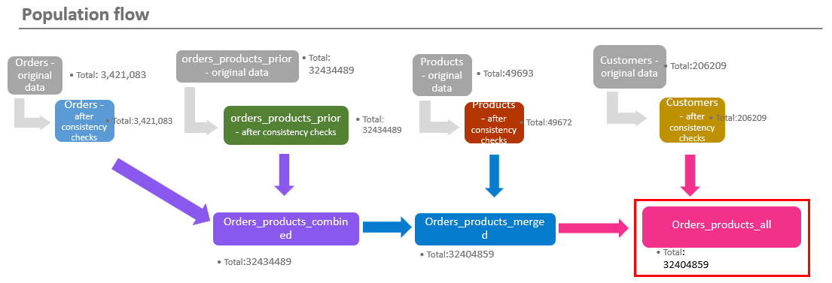

Instacart
Marketing Strategy for an Online Grocery Store

Slide 19
Project analysis slide 5
Instacart
Project Overview: Instacart, a top online grocery platform, enables customers to order groceries through an app. The company sought to increase sales by leveraging historical data to implement a more strategic approach to customer targeting and segmentation.
Objective: This project aimed to conduct an in-depth analysis of Instacart’s sales data to refine their marketing strategy, with a focus on precise customer targeting and effective segmentation to drive sales growth.
Key Steps:
Write Python Scripts: Developed Python scripts and documented the analysis using Jupyter Notebook.
Import: Loaded datasets and essential Python libraries.
Data Cleaning and Wrangling: Employed Pandas and NumPy for data cleaning, transformation, and preparation.
Aggregation Functions: Applied aggregation functions for data analysis.
Export: Exported datasets to pickle and CSV files.
Data Quality and Consistency: Conducted data quality checks, including frequency counts.
Exploratory Data Analysis (EDA): Performed data manipulation, grouping, aggregation, and derived new variables.
Visualization: Created graphs and visualizations using Matplotlib, Seaborn, and SciPy.
Export Data Frames: Exported cleaned and processed data frames for reporting.
Jupyter
Python
Anaconda
Python Libraries
TOOLS USED

Slide 20
Project analysis slide 8
Instacart
Key Questions
Data
1. What are the busiest days of the week and hours of the day?
2. At what times of the day do people tend to spend the most money?
3. How can simple price range groupings be used to optimize marketing and sales efforts?
4. Which types of products are most popular?
5. What are the characteristics and spending habits of different customer profiles
Data Sets: Customers: Analyzed for purchasing patterns and loyalty.
Orders: Studied to determine busy times and spending habits.
Products: Categorized to understand popularity and sales impact.
Departments: Analyzed for sales volume per department.
Data Citations: "The Instacart Online Grocery Shopping Dataset 2017", Accessed via Kaggle. "Customers Data Set", Provided by CareerFoundry.
Skills Applied
Challenges
Python Programming:
Utilized in Jupyter Notebook for all coding and analysis tasks.
Data wrangling, subsetting, filtering, and summarizing with Pandas.
Data merging and consistency checks to ensure accuracy.
Deriving new variables and complex data transformations.
Grouping and aggregating data for detailed insights.
Data Visualization: Advanced visualizations created using Matplotlib and Seaborn.
Presentation of analytical results through clear and effective charts.
Managing the dataset's 30 million records presented significant challenges in cleaning, standardizing, and formatting for analysis.
Memory shortages were addressed through efficient coding practices, ensuring effective data transformation.

Slide 21
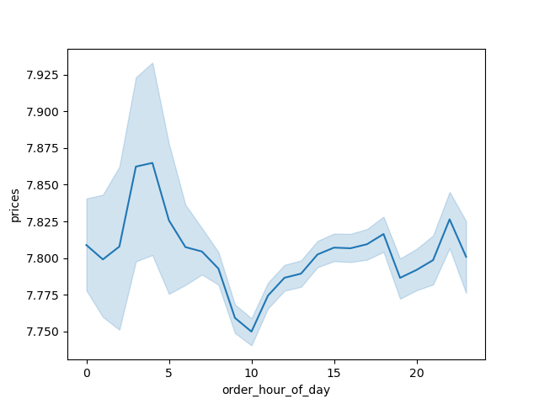
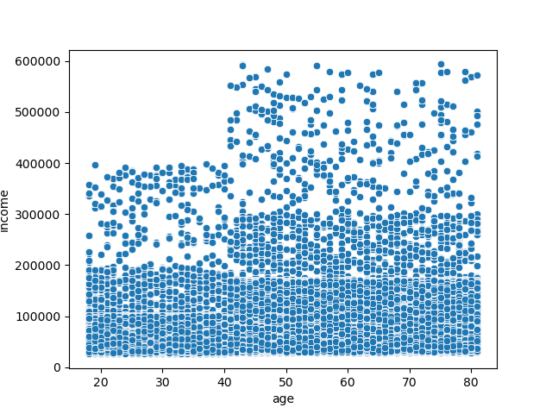
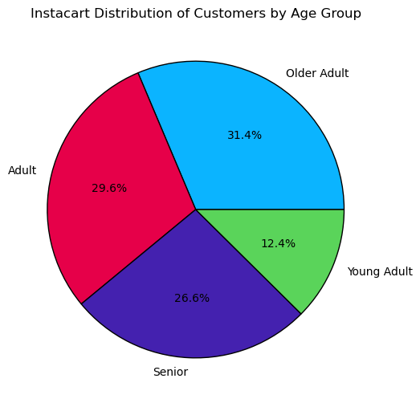
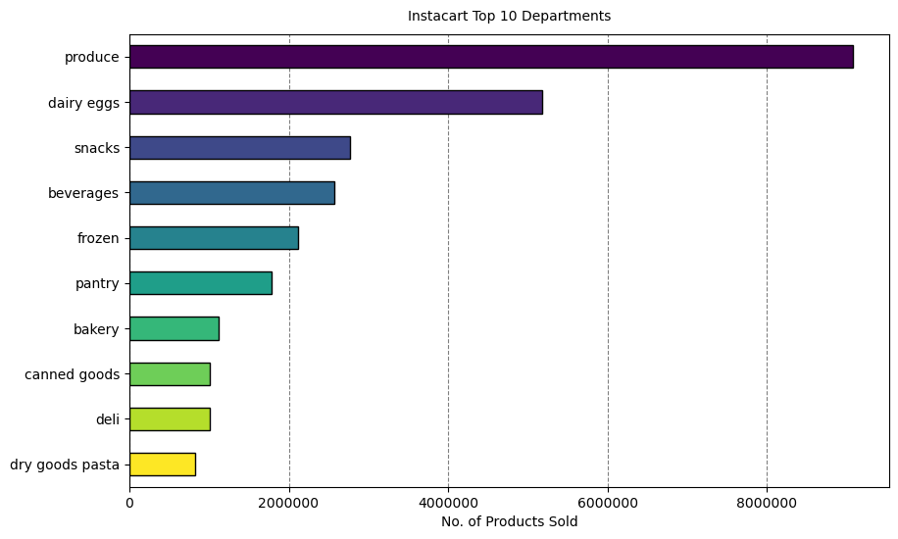
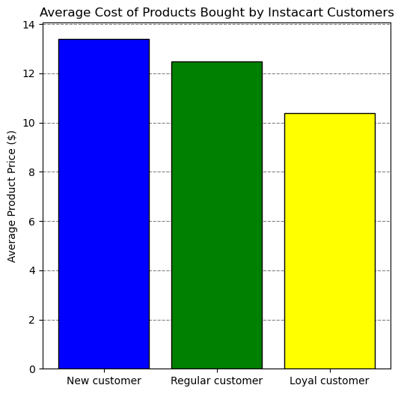
Project analysis slide 5
Analysis
The process began with the cleaning and merging of multiple datasets to ensure accuracy, utilizing Pandas for data wrangling, aggregation, and feature derivation. Key trends, such as peak shopping times and popular product categories, were identified, and customer purchasing behaviors were explored. Outliers were removed to refine the dataset. The comprehensive analysis provided actionable insights for crafting targeted marketing campaigns.
Ordering Patterns
Customer Profiles
Sales Distribution

Slide 22
Project analysis slide 5
Insights & Recommendations
KEY LEARNINGS
1. Busiest ordering days are Saturday and Sunday. Busiest hours are between 9AM-4PM.
2. People tend to order more expensive items before 6-7 AM
3. The majority of the products people order are low-range (<5 USD) & mid-range (5-10 USD).
4. Most popular products are fresh food products (produce, meat and sea food, dairy and eggs, deli, bakery).
5. The most significant variation in shopping behavior among customer groups relates to income, particularly in the average price of orders.
RECOMMENDATIONS
Marketing and Sales
Customer Profiles
Further Analysis
Target ads during lower order volumes in the early evening on weekdays to capitalize on increased social media usage. Focus on promoting high-end products early in the morning and late at night, using time-limited offers to create a sense of urgency.
Utilize loyalty data to tailor campaigns, particularly promoting premium products to high-income customers like Gen X and Baby Boomers. Implement referral programs that reward loyal customers for bringing in new shoppers, focusing on bulk purchase promotions for families.
Explore variations in the busiest shopping hours and days, and analyze purchasing trends for different product types during specific times. Examine underperforming high-range products to understand customer purchasing behaviors and preferences better.
LINKS & DELIVERABLES
GitHub Repository
Final Report

Slide 23

Global Bank
ANTI-MONEY LAUNDERING PROJECT

Slide 24
Project analysis slide 5
Global Bank
Pig E. Bank is a global bank dedicated to providing exceptional financial services.
Objective The aim of this project was to perform an in-depth analysis of customer satisfaction data at Pig E. Bank. This analysis targeted the identification of factors leading to customer attrition with the ultimate goal of developing robust strategies to improve customer retention.
Key Steps:
Write Python Scripts: Developed Python scripts and documented the analysis using Jupyter Notebook.
Import: Loaded datasets and necessary Python libraries.
Data Cleaning and Wrangling: Used Pandas and NumPy for data cleaning, transformation, and preparation.
Data Quality and Consistency: Conducted data quality checks, including frequency counts.
Exploratory Data Analysis (EDA): Performed data manipulation, grouping, aggregation, and derived new variables.
Visualization: Created graphs and visualizations using Matplotlib, Seaborn, and SciPy.
Export: Exported datasets to XLSX files.
Jupyter
Python
Anaconda
Python Libraries
TOOLS USED

Slide 25
Project analysis slide 8
Global Bank
Key Questions
Data
What are the key risk-factors in identifying customers who are most likely to churn?
Data source: Career Foundry
Skills Applied
Challenges
Big data
Data ethics
Data mining
Predictive analysis
Time series analysis and forecasting
Using GitHub
Challenges included managing complex queries and maintaining data accuracy.

Slide 26
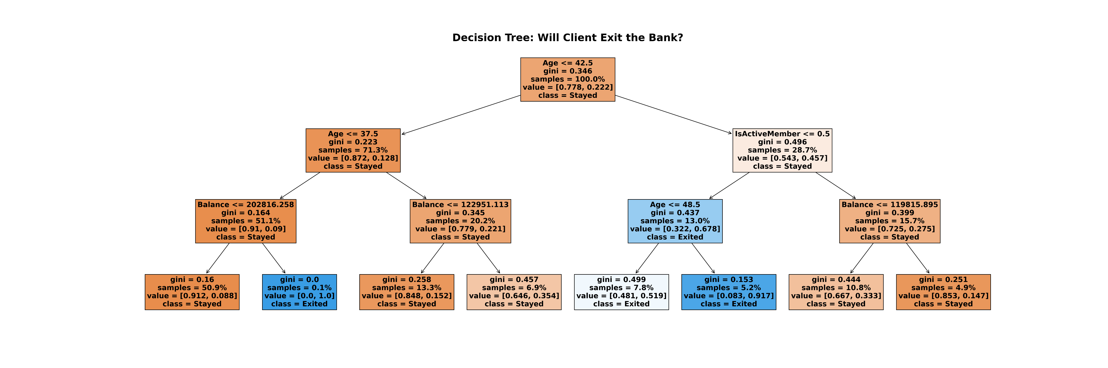
Project analysis slide 5
Analysis
The characteristics of structured and unstructured data were initially analyzed. Data was cleaned and mined using Excel, Python, and GitHub, with predictive models and time-series forecasts being developed. Data bias and ethical issues were addressed to ensure the integrity and security of the data.
A decision tree was created, highlighting key factors leading to customer churn, such as Age, Account Balance, Credit Score, and Salary.

Slide 27
Project analysis slide 5
Insights & Recommendations
KEY LEARNINGS
Being an inactive member seems to be a major contributing factor in leaving the bank.
A higher proportion of the people who left the bank are above age 45.
A larger proportion of the former customers have higher account balance (between 100k-140k and also balances more than 150k).
Majority of the former customers held only one product.
RECOMMENDATIONS
Activity
Age
Account Balance
Products
Increase customer engagement through loyalty programs, personalized offers, and regular communication.
Develop tailored financial products and services that cater specifically to the needs of people above 45.
Enhance personalized financial advisory services tailored for the financial needs of people with higher balances.
Encourage product diversification among customers.

Slide 28
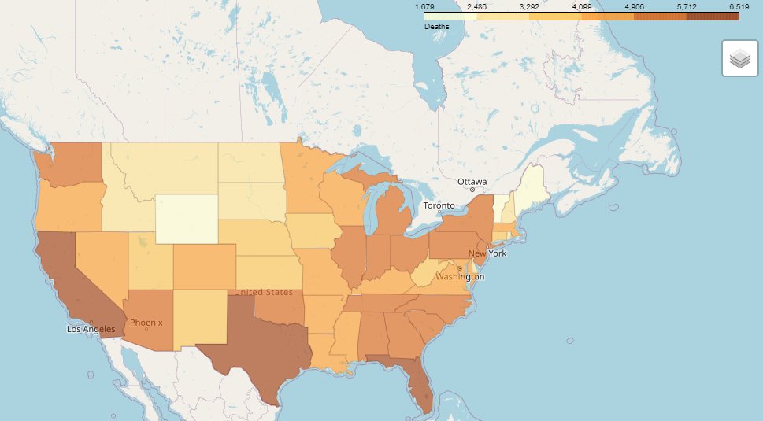
Conditions Contributing to COVID-19 Deaths

Slide 29
Project analysis slide 5
Conditions Contributing to COVID-19 Deaths, by State and Age, Provisional 2020-2023
The goal of this project is to analyze the factors contributing to COVID-19 deaths in the U.S., utilizing the CDC's dataset titled "Conditions Contributing to COVID-19 Deaths, by State and Age, Provisional 2020-2023." The project aims to examine demographic, geographic, and temporal trends in COVID-19 mortality, with a focus on how various conditions influenced death counts over time and across different states. This analysis will provide valuable insights into the pandemic's impact on different populations and the role specific conditions played in mortality rates.
Key Steps:
Write Python Scripts: Developed Python scripts and documented the analysis using Jupyter Notebook.
Import: Loaded datasets and necessary Python libraries.
Data Cleaning and Wrangling: Used Pandas and NumPy for data cleaning, transformation, and preparation.
Data Quality and Consistency: Conducted data quality checks, including frequency counts.
Exploratory Data Analysis (EDA): Performed data manipulation.
Visualization: Created graphs and visualizations using Matplotlib, Seaborn, and SciPy.
Export: Exported datasets to XLSX files.
Jupyter
Python
Anaconda
Python Libraries
TOOLS USED

Slide 30
Project analysis slide 8
Conditions Contributing to COVID-19 Deaths, by State and Age, Provisional 2020-2023
Key Questions
Data
Does a higher number of mentions of specific conditions on death certificates lead to a significantly higher COVID-19 death count?
Data source: Career Foundry
Skills Applied
Challenges
Exploratory data analysis
Geographical visualizations with Python
Regression analysis on Python
Clustering on Python
Sourcing open data
Sourcing time series data
Data dashboards
Challenges included managing complex queries and maintaining data accuracy.

Slide 31
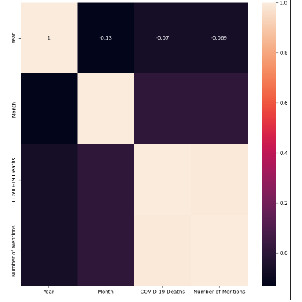
Project analysis slide 5
Analysis
I analyzed the COVID-19 data of U.S. from 2020 to 2023.
The following results are delivered:
• A detailed repository on GitHub with all Python Code
• A thorough data storyboard on Tableau including all necessary visualizations, demonstrating the objective, hypothesis, test results, and conclusion of the analysis.
1. Exploratory analysis of variables
The analysis revealed a correlation value of 0.989 between "COVID-19 Deaths" and "Number of Mentions," indicating a strong positive correlation between the two variables. This suggests that as the number of COVID-19 deaths increases, the number of mentions of contributing conditions tends to rise proportionally. However, it is essential to recognize that correlation does not imply causation. Although the two variables are closely related, this statistical relationship does not necessarily mean that one causes the other; rather, they tend to move together.

Slide 32
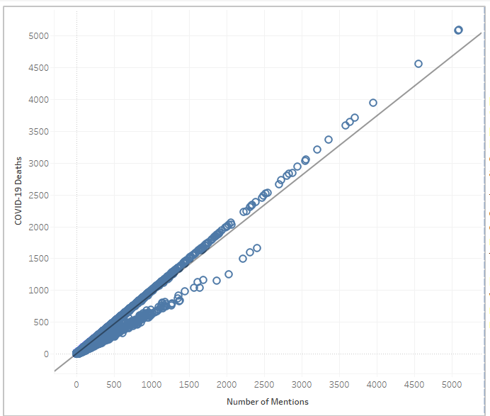
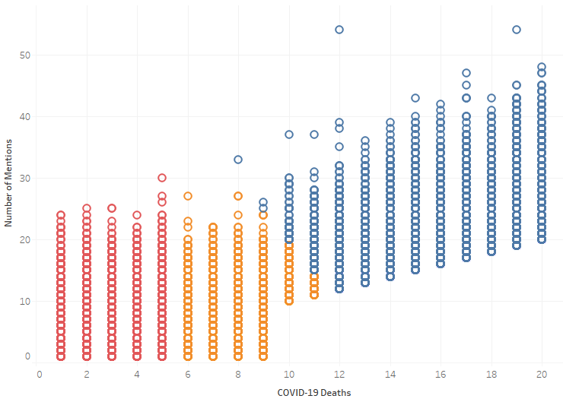
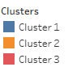
2. Regression Analysis
3. Cluster Analysis
I conducted a regression analysis to examine the relationship between "COVID-19 Deaths" (independent variable) and "Number of Mentions" (dependent variable). All the data points are close to the regression line exhibiting the Strong Relationship. This suggests that as the number of COVID-19 deaths increases, the number of mentions tends to increase as well.
Cluster 1 (Low Deaths, High Mentions) could represent countries that handled the pandemic well but received media attention for their efforts.
Cluster 2 (High Deaths, High Mentions) might highlight the countries hit hardest by the pandemic, receiving corresponding media attention.
Cluster 3 (Low Deaths, Low Mentions) might represent regions with minimal impact and visibility.

Slide 33
Project analysis slide 5
Insights & Recommendations
Summary
The close alignment of data points with the regression line in your analysis of "COVID-19 Deaths" and "Number of Mentions" indicates a strong positive relationship. This suggests that as COVID-19 deaths increase, the number of mentions increases proportionally, and the model is effective for predicting and understanding this relationship.
Recommendations: Strengthen global communication to highlight effective pandemic strategies, especially in underrepresented regions, and ensure equitable resource distribution.
Future Research: Investigate outliers and explore factors like healthcare infrastructure or policy effectiveness that influenced pandemic outcomes beyond media attention.
From a sampling point of view, bias could occur if the dataset over-represents certain regions or time periods, leading to an inaccurate reflection of the global situation by emphasizing areas with more available or easily accessible data while underreporting others.
Limitations and Ethical Considerations
The dataset is provisional, so conclusions may require updates. It has reporting delays, inconsistent state standards, data suppression, and potential for double counting of deaths with multiple conditions. Ethical considerations include privacy risks, sensitivity of death-related data, and the possibility of demographic underrepresentation or geographic biases.

Slide 34
Project analysis slide 5
Conclusions
Journey
My journey in data analytics was showcased, with complex data being transformed into impactful stories.
Skills
My skills in data cleaning, analysis, and visualization are highlighted by each project.
Future
Advanced predictive models are integrated, and dashboards are refined for improved decision-making
Experience
A unique perspective in data storytelling is brought, driving strategic decisions and delivering actionable insights.
Thank you

